Slide 1
Performance Analysis of IEEE802.11 Distributed Coordination Function (DCF)
IEEE JSAC 2000
Author : Giuseppe Bianchi
This presentation is based on that of wqh and Prof. Jean-Pierre Hubaux with few modifications

Slide 2
Outline
Overview of IEEE 802.11 DCF
Mathematical model
  Notations
  Bi-dimensional Markov Chain
  One step transition probabilities
  Stationary distribution
Performance evaluation of DCF
Conclusion

Slide 3
Overview of IEEE 802.11
MAC and PHY layers specifications for wireless LANs
MAC Protocols
  Fundamental: Distributed Coordination Function (DCF)
    Binary Exponential Backoff rules
    Access techniques: CSMA/CA based
  Optional: Point Coordination Function (PCF)

Slide 4
Overview of IEEE 802.11 DCF
Backoff procedure—BEB algorithm
Backoff counter:
Initial: uni~[0, W-1]
Non zero: decremented for
each idle slot
Zero: transmit
W
W_{max}
c
c
s
s
c
W_{min}
c
c
c
c
C
c
s
t

Slide 5
Overview of IEEE 802.11 DCF
CSMA/CA: two access techniques
  Basic mechanism: 2 way handshaking
  RTS/CTS mechanism: 4 way handshaking
RTS
DATA
CTS
DESt
Source
Dest
Source
DATA
ACK
ACK

Slide 6
Basic mechanism
Sending unicast packets
  Sender has to wait for at least DIFS before sending data
    Wait for at least DIFS before performing binary backoff (which is before sending data)
    Note: sender immediately transmits data without waiting for DIFS once backoff counter reaches zero.
  Receiver acknowledges at once (after waiting for SIFS) if the packet was received correctly (CRC)
  Sender retransmits data packets in case of transmission errors
  Other stations defer access
Immediate access when medium is free ≥ DIFS (Figure 51 in 802.11-2003 std)
DIFS
data
sender
SIFS
ACK
receiver
DIFS
other
stations
data
t
Defer access
Contention
window
The ACK is sent right at the end of SIFS
(no contention)

Slide 7
RTS/CTS mechanism
Sending unicast packets
  Sender can send RTS with reservation parameter after waiting for ≥DIFS (reservation determines amount of time the data packet needs the medium)
    Wait for at least DIFS before performing binary backoff (which is before sending data)
    Note: sender immediately transmits data without waiting for DIFS once backoff counter reaches zero.
  Receiver acknowledgement via CTS after SIFS (if ready to receive)
  Sender can now send data at once, acknowledgement via ACK
  Other stations defer access by setting NAV via RTS and CTS
Immediate access when medium is free ≥ DIFS (Figure 51 in 802.11-2003 std)
DIFS
RTS
data
sender
SIFS
SIFS
SIFS
CTS
ACK
receiver
NAV (RTS)
DIFS
other
stations
data
NAV (CTS)
t
defer access
Contention
window
NAV: Net Allocation Vector
RTS/CTS can be present for
some packets and not for other

Slide 8
Backoff Counter in RTS/CTS mechanism
RTS/CTS mechanism
Idea: reserve channel via RTS/CTS; avoid DATA collision, rather than RTS collision
Process: DIFS+contention+RTS+SIFS+CTS+SIFS+DATA+SIFS+ACK
BO=backoff counter
SIFS
BO=3 (set)
A
BO=0
BO=5 (set)
BO=15 (set)
DIFS
RTS
DATA
DIFS
RTS
DIFS
CTS
ACK
collision
B
BO=8 (set)
BO=5 (suspend)
BO=5(resume)
BO=10 (set)
C
BUSY
DIFS
NAV (RTS)
DIFS
RTS
DIFS
NAV(CTS)

Slide 9
Bianchi’s Model: Topology and Objective
Topology: n links within one-hop network
3
2
4
1
2
3
n
1
AP
n-2
n
n-1
Objective: Consider a tagged node to calculate the per-node saturation throughput.
To this end, we first calculate p, governing all other performance metrics.
MAC Layer
τ
= Probability of Transmission
PHY Layer
P
= Probability of Collision
= More than one transmission at the same time
= 1 – (1- τ)^{n-1}

Slide 10
Analytical Model to Evaluate DCF
Saturation:
  each node (link) always has a packet to transmit.
Saturation throughput:
  The limit is reached by the system throughput as the offered load increases
  The limit represents the maximum load that the system can carry in stable conditions

Slide 11
Analytical Model to Evaluate DCF
Assumptions
  all nodes reside in a single-cell network
    i.e., all stations are in sensing range of each other
  The collision processes of the nodes can be decoupled.
    i.e., at each transmission attempt, and regardless of the number of retransmissions suffered, each packet collides with constant and independent probability.
  Channel conditions are ideal:
    transmission errors are a result of packet collision only.
    no hidden and exposed terminals
Notes:
The original expression in Bianchi JSAC00 paper: The key approximation in our model is that, at each transmission
attempt, and regardless of the number of retransmissions suffered, each packet collides with constant and independent
probability .

Slide 12
Bi-dimensional Markov Chain model
Notations
  Time scale:
    Time is in slot, so it is discrete and integer.
    ti represents the beginning of i-th backoff counter decrease.
    [ti, ti+1] = interval between 2 consecutive backoff counter decrease.
      It is called a generic slot time, which can be variable length & is defined in next slide.
  Makovian State: B(t) ={s(t), b(t)}
    s(t): backoff stage at time t, which is ∈ [0, m]
    b(t): backoff time counter at time t, which is ∈ [0, Wi], i=s(t)
  m: maximum backoff stage, Wmax = 2^{m}Wmin
  Wi = 2^{i}Wmin, i∈ [0, m] represents backoff stage
  p: prob.of each transmitted packet being collided
Model behavior of a single station

Slide 13
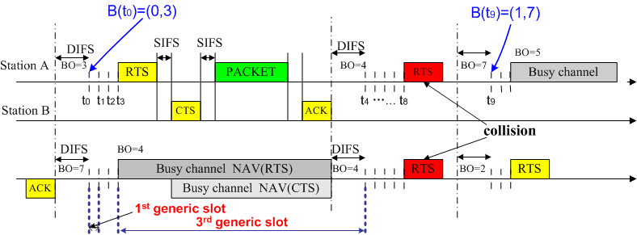
Example of B(t) ={s(t), b(t)} & generic slot
BO=backoff counter
, 1σ
2nd generic slot, Tc
,Ts
1 generic slot = 1σ, a fixed idle time
= Tc, time of collision
= Ts, time to transmit a packet of size L

Slide 14
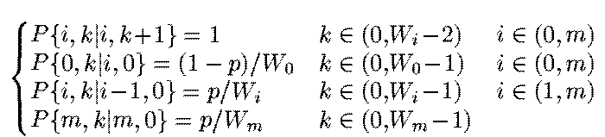
Bianchi’s Model: Two Dimensional Markov chain
(s(t), b(t))
(Backoff Stage, Backoff Timer)
1
-
p
1
/
W
0
(
0
,
0
)
1
(
0
,
1
)
1
(
0
,
2
)
1
(
0
,
W
0
-
2
)
1
(
0
,
W
0
-
1
)
p
/
W
1
(
i
-
1
,
0
)
p
/
W
i
(
i
,
0
)
1
(
i
,
1
)
1
(
i
,
2
)
1
(
i
,
W
i
-
2
)
1
(
i
,
W
i
-
1
)
p
/
W
i
+
1
(
m
-
1
,
0
)
p
/
W
m
(
m
,
0
)
1
(
m
,
1
)
1
(
m
,
2
)
1
(
m
,
W
m
-
2
)
1
(
m
,
W
m
-
1
)
p
1
/
W
m

Slide 15
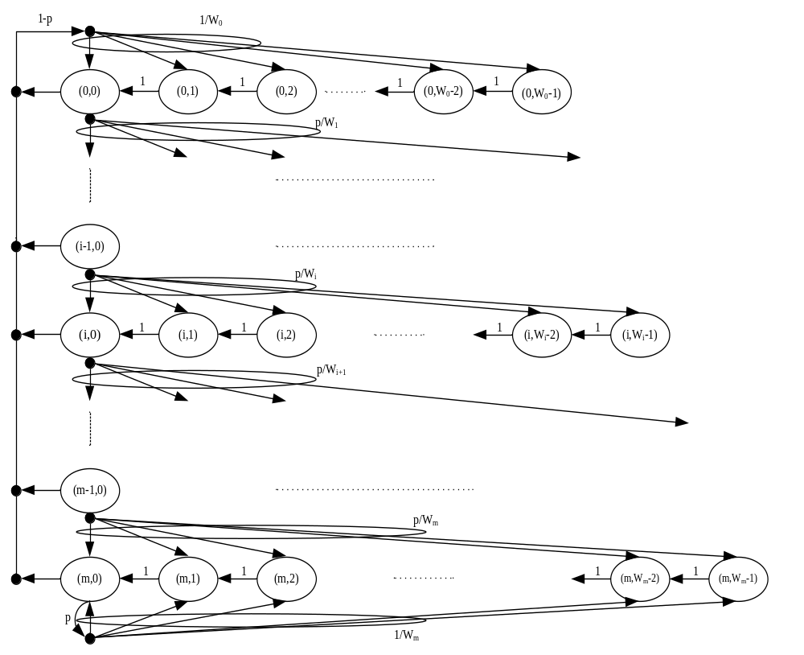
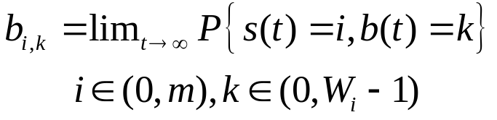
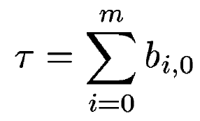
Bianchi’s Model: Two Dimensional Markov chain
Stationary distribution:
Probability of transmission

Slide 16

Bianchi’s Model: Two Dimensional Markov chain
Successful
Transmission

Slide 17

Bianchi’s Model: Two Dimensional Markov chain
Collision

Slide 18
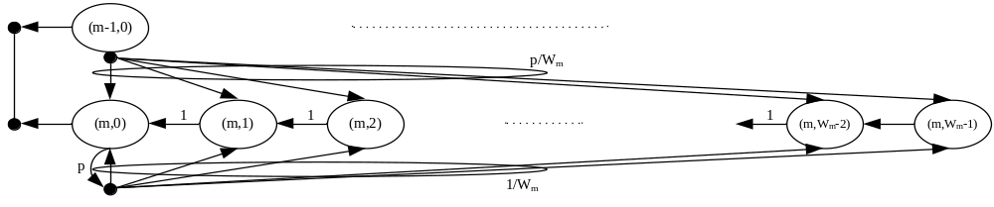
Bianchi’s Model: Stationary Distribution of Chain
(Find closed-form solution)
(
i
-
1
,
0
)
p
/
W
i
(
i
,
0
)
1
(
i
,
1
)
1
(
i
,
2
)
1
(
i
,
W
i
-
2
)
(
i
,
W
i
-
1
)
    Global balance equations
b_{i,0} = p b_{i-1,0}
How to obtain this equation? Try it!
    Questions: How about the retransmission limit K <∞
b_{m,0} = p b_{m-1,0} + p b_{m,0}
    Bianchi model assumes the retransmission limit K = ∞

Slide 19
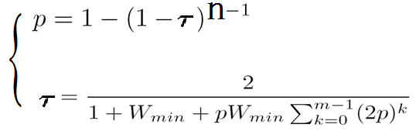
Bianchi’s Model: Solution for p and τ
After some derivations → system of two nonlinear equations with two variables p and τ:
Question:
  Form a fixed-point equation with respect to p after substituting 2nd equation into 1st equation.
  calculate numerically the collision probability p by the fzero() function in Matlab. (Final-exam problem)

Slide 20
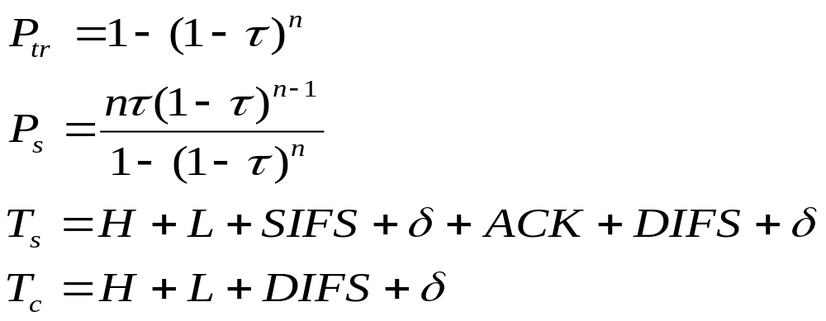
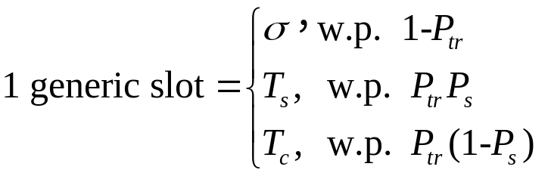
Bianchi’s model: Throughput Calculation
Throughput of node i:
  P_{tr}: Probability of at least one transmission in slot time
  P_{s}: Probability of successful transmission of during a random time slot
  L: Average packet payload size
  T_{s}: Average time to transmit a packet of size L
  T_{c}: Average time of collision
  T_{id}: Duration of the idle period= 1σ
  ACK: ACK transmission time
  H: PHY and MAC Header transmission time; δ is the propagation delay
    Note:
    How to max saturation throughput can be
    found in Section VI in the Bianchi paper

Slide 21
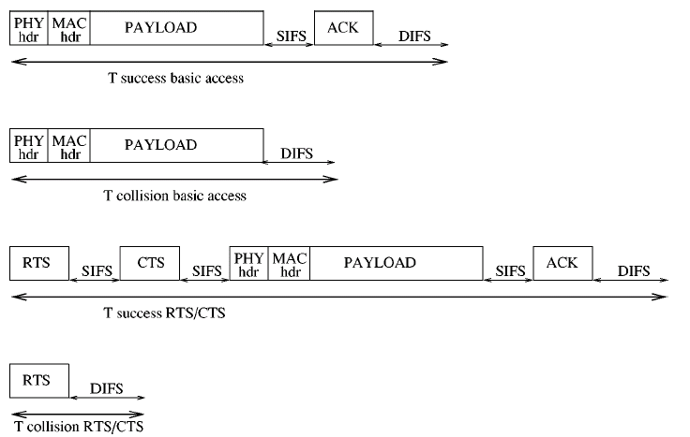
Length of T_{s} and T_{collision}

Slide 22
Performance evaluation of 802.11DCF (1)
Parameters | Basic Access | RTS/CTS
Network size | Sensitive | Insensitive
τ | Sensitive | Insensitive
Wmin | Dependent | Independent
Wmax | Marginal effect | Negligible effect
Packet size |  | More effective for longer packets
Notes:
negligible /ˈneɡlɪdʒəbl/

Slide 23
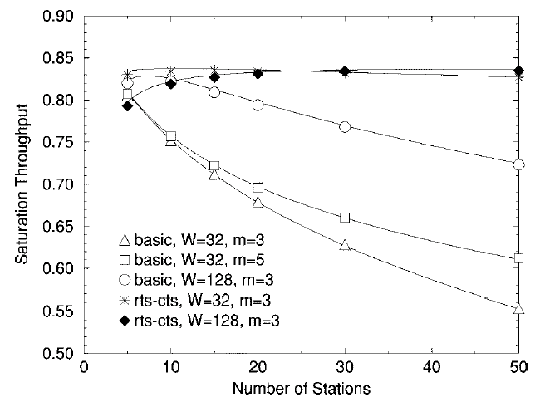
Network size vs. throughput
Performance evaluation of 802.11DCF (2)
Basic and RTS/CTS access schemes

Slide 24
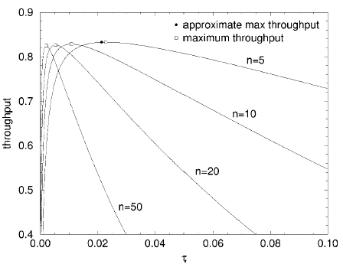
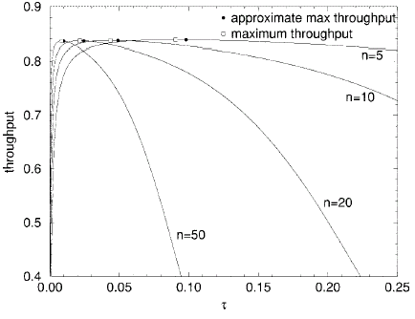
τ τ vs. Throughput
Performance evaluation of 802.11DCF (3)
Basic Access
RTS/CTS

Slide 25
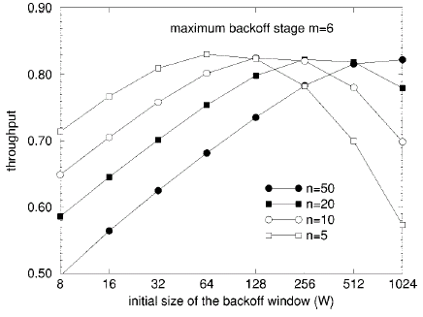
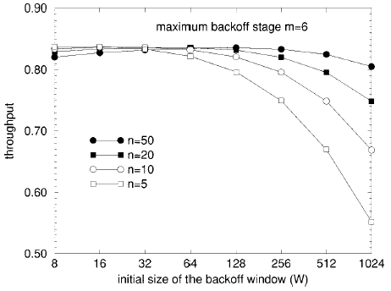
Wmin vs. Throughput
Performance evaluation of 802.11DCF (4)
Basic Access
RTS/CTS

Slide 26
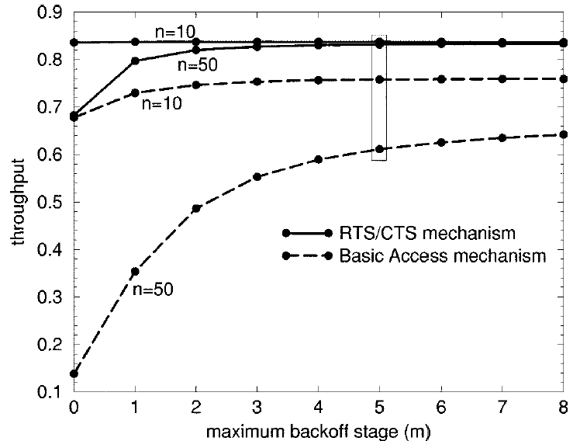
Wmax vs. throughput
Performance evaluation of 802.11DCF (5)
(Wmin = 32)

Slide 27
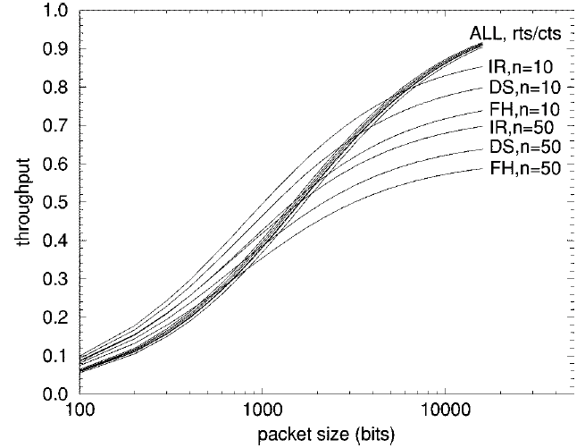
Packet length vs. throughput
Performance evaluation of 802.11DCF (6)

Slide 28
Conclusion
Major contributions
  Proposed analytical model
    Accurate: verified by simulations
    Simple
    Account for all exponential backoff details
    Evaluate basic and RTS/CTS access schemes
  Performance evaluation on saturation throughput

Slide 29
Homework- analysis (very important)
Solve the fixed-point equation in pp.19
  Write a Matlab script to calculate collision prob., p, given Wmin = 32, m = 5, and n=1:1:30.
    Hint: call fzero() funciton in Matlab.
    I will test this problem!!!
  Plot the collision probability as the number of station increases from 1 to 30 using MATLAB
  Plot the saturation throughput as the number of station increases from 1 to 30 using MATLAB

